Slide 1

BT
Wallet
BT Wallet
Business plan
Team Block Taker

Slide 2

Content
BT
Wallet
01
Introduction
02
Main Functions
03
Features
04
Demo
05
Future Plan

Slide 3

BT
Wallet
01
Introduction

Slide 4
BT
Wallet
Why build a BT wallet?

Slide 5



BT
Wallet
Hardware Advantage
Wallet Security
Enrich Polkadot Ecosystem
Members of our team have many years of experience in hardware development and security chip algorithms, and have been deeply involved in the fields of traditional financial security and network security for many years.
With the increasing development of the blockchain industry, digital assets are being stolen in an endless stream. Most of the reasons are due to the leakage of private keys or access to the Internet, which gives hackers an opportunity. Wallet security has become one of the biggest problems in the encryption field. At present, the entire Polkadot wallet ecosystem does not have a relatively mature and well-known security wallet, which provides our team with an opportunity to enter the Polkadot ecosystem.
No matter participating Polkadot nominator operate from the official website or other wallets, users need to go through complex processes such as binding, unbinding, screening validators, and withdrawing principal, and they also face the problem of unstable income, which increases the The threshold for users to participate in Polkadot nomination has affected the growth of Polkadot ecosystem.

Slide 6
BT
Wallet
BT Wallet

Slide 7

BT
Wallet
BT wallet is a lightweight security wallet based on Polkadot, integrated encryption chips and other hardware facilities.
Security Chip
BT wallet through the independent security chip equipped with specific mobile terminal, the private key is stored separately and isolated from the Internet, providing users with high-security encryption asset private key creation, storage, use and recovery functions, truly Realized "separation of hot and cold ends, private key never touches the Internet"
The Nominator
Through the PLBM Smart Algorithm, greatly reduces the complexity of ordinary users, provides one-click nominator function on the mobile phone, and through the intelligent recommendation algorithm maximizes user benefits.
We are committed to making BT Wallet a next-generation Web3 super traffic portal, attracting more users and even professional users to embrace the Polkadot ecosystem.

Slide 8

BT
Wallet
02
Main functions

Slide 9

Financial Grade Chip Security Encryption
BT
Wallet
Based on Financial Grade EAL6+ security chip technology. The BT wallet stores the private key separately and isolates it from the Internet by connecting with the independent security chip on the specific mobile terminal, providing users with the creation, storage, use and recovery of the private key of encrypted assets with high security, and truly realizing the " The hot and cold ends are separated, and the private key never touches the Internet."

Slide 10
Security Chip Hardware Structure Diagram
BT
Wallet
ROM
32KB(CODE)
32KB(DATA)
SRAM
64KB
SRAM
64KB
SRAM
64KB
SRAM
64KB
AHB Matrix
EFLASH 1.25MB
Security
Components
CRYPTO
Cache(16k)
SM4
DES/3DES
CS0
SRAM
64KB
EMMC/SD
Security Chip
SM1
SM3/SHA
PMC
AES
SSF33
CRM
NFC
Processor System
Storage
WDT
TRNG
USB2.0
APB/IPS BUS
CAMC
PIT x 2
LED
CRC
LD
PGD
Communication
Port
HACC
FD/VD
TS/MESH
TC
DMA
SWP
USI x 3
I2C
SCI x 2
EPORT
SPI x 3

Slide 11
BT
Wallet
Polkadot Wallet
Create Wallet
Mnemonic
Mnemonic Import
Import Wallet
Import Private Key
Polkadot
DApp
Polkadot Network DApp
Staking
Nominator

Slide 12
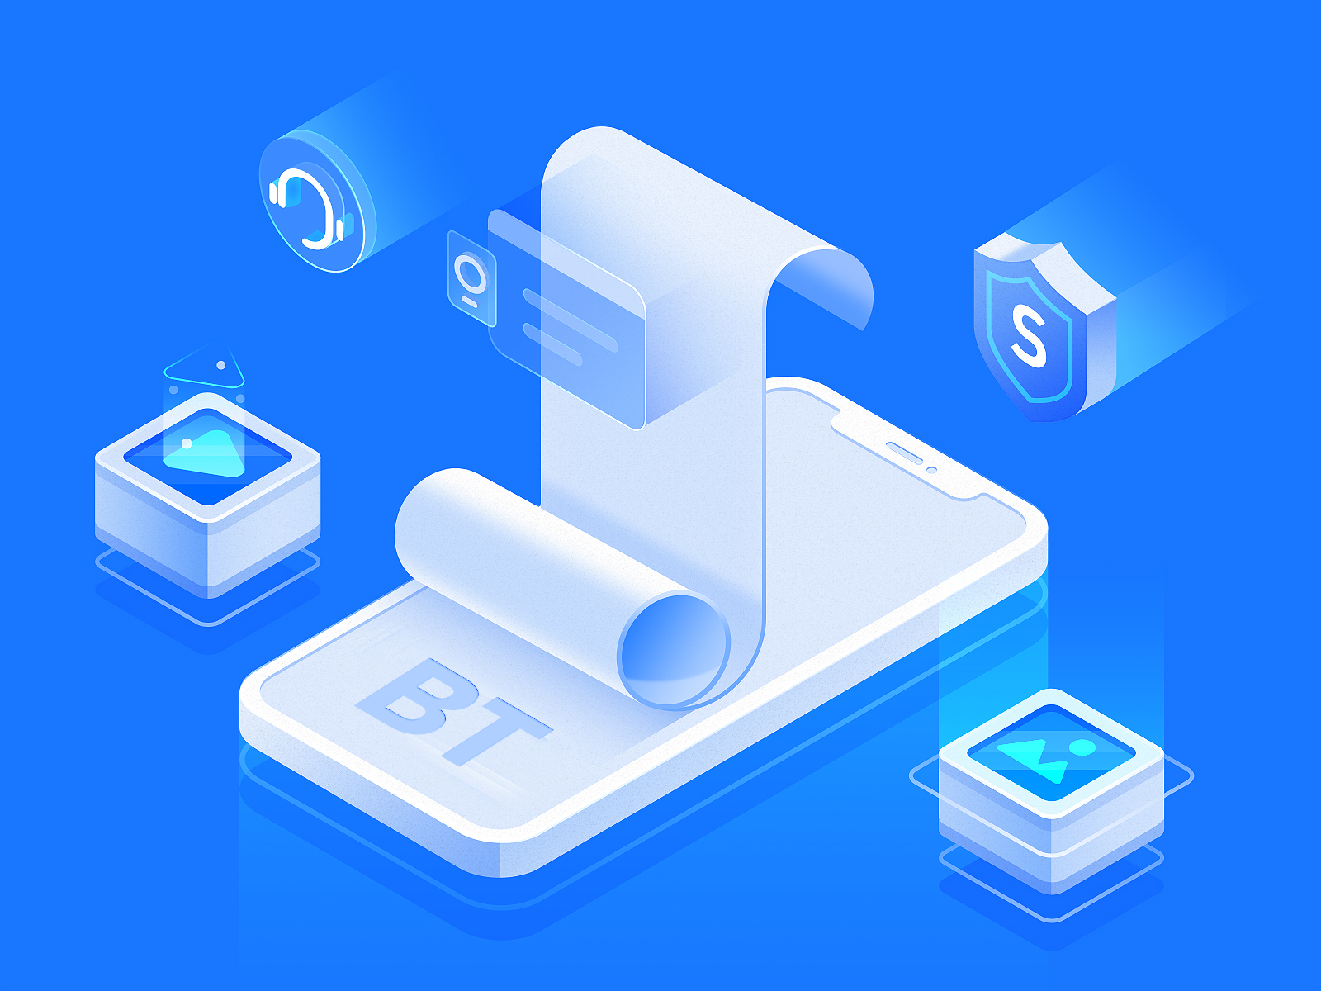
Nominator
BT
Wallet
The nominator function of the BT wallet is to obtain the validator and nominator data through the API interface, and encapsulate the data through the PLBM Smart Algorithm. Quantity, intelligently recommend 16 optimal verifiers and help users complete nominator operations. The intelligent recommendation system will recommend how much you invest to get rewards, and when the user is about to be out of the nominator candidate list (the first 256 nominators of a validator node have rewards), timely remind the user to replenish the amount to stabilize the ranking and other methods to achieve the least user investment. Earn the most.

Slide 13




BT Wallet VS Other Wallet
BT
Wallet
One-click
Operation
End
BT Wallet
USER
Staking
Choose
validators
Nominate
End
Other Wallet
Validator
Change Info

Slide 14
Staking Operation Flow Chart
BT
Wallet
Open BT Wallet
Choose
Nominator
Automatic Completion
Enter the Amount
of DOT Bond
PLBM
Smart Algorithm
Authorize
16 Validators
are Elected
Success
Automatic Completion
Done

Slide 15
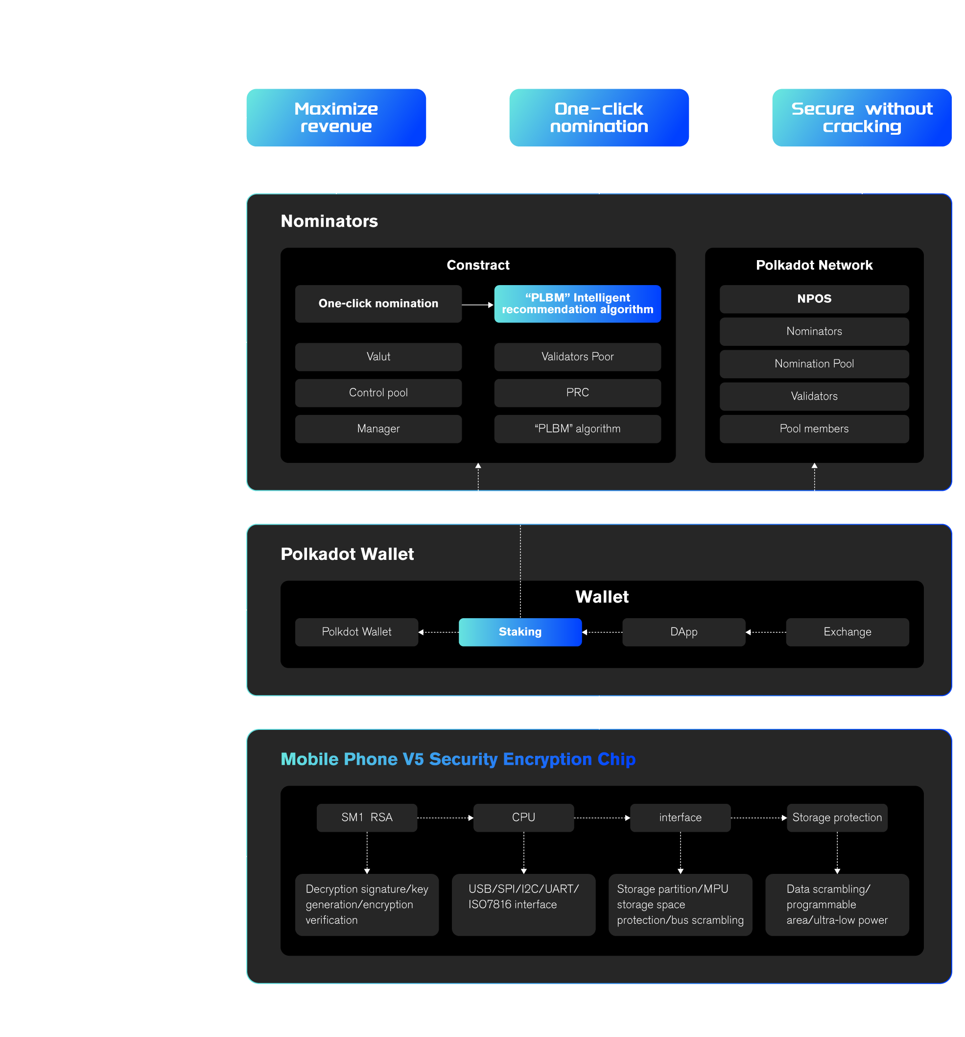
BT
Wallet
Technical Framework of BT Wallet

Slide 16

BT
Wallet
03
Features

Slide 17
BT
Wallet
Safe, never hackable
Advantages
One-click nomination
Based on independent cryptography technology and rich security services, it realizes three-dimensional protection from chip, terminal and cloud, and provides multi-dimensional and all-round security for terminals
No cumbersome steps, one-click nomination, built-in danger warning mechanism, so that you don't miss any nomination opportunities
PLBM Smart Algorithm
Minimum investment, maximum income. By processing the data of verifiers and nominators on the Polkadot network (the RPC interface takes data and analyzes the data), the system will intelligently remind users how much they invest to get rewards, how to choose verifiers, and when the user is about to become a nominator candidate Out of the list (the first 256 nominators of a validator node are rewarded) to remind users to operate in a timely manner to stabilize the ranking and other methods to maximize user benefits.

Slide 18

BT
Wallet
04
Demo

Slide 19
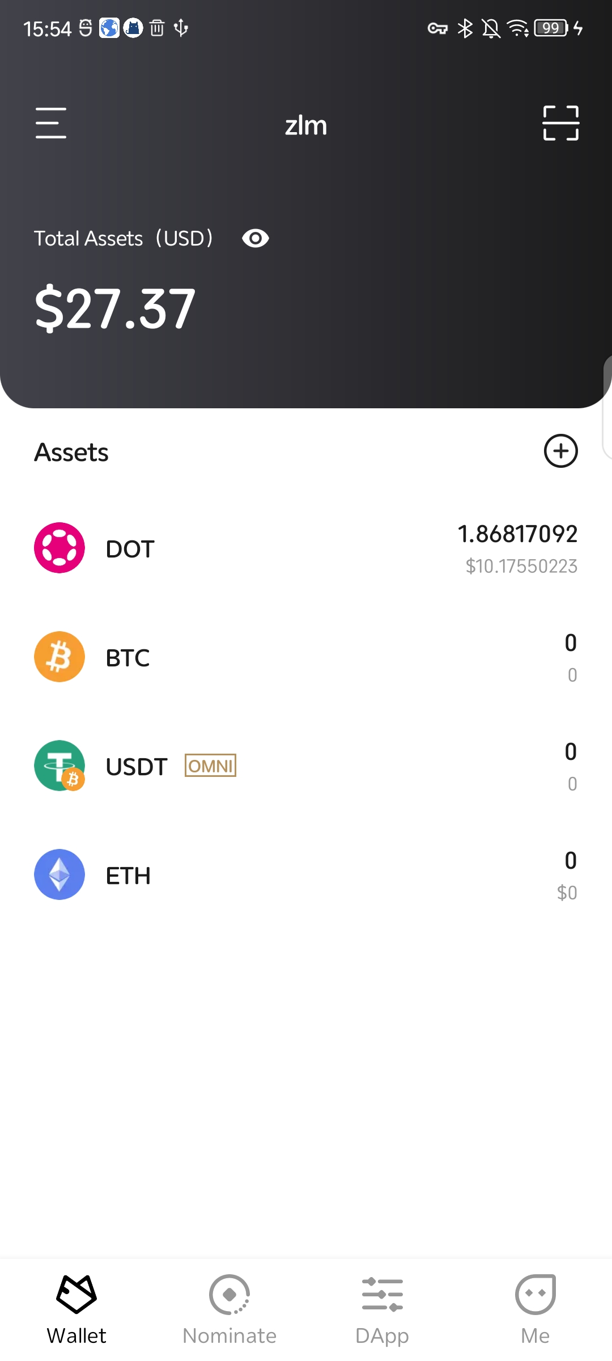
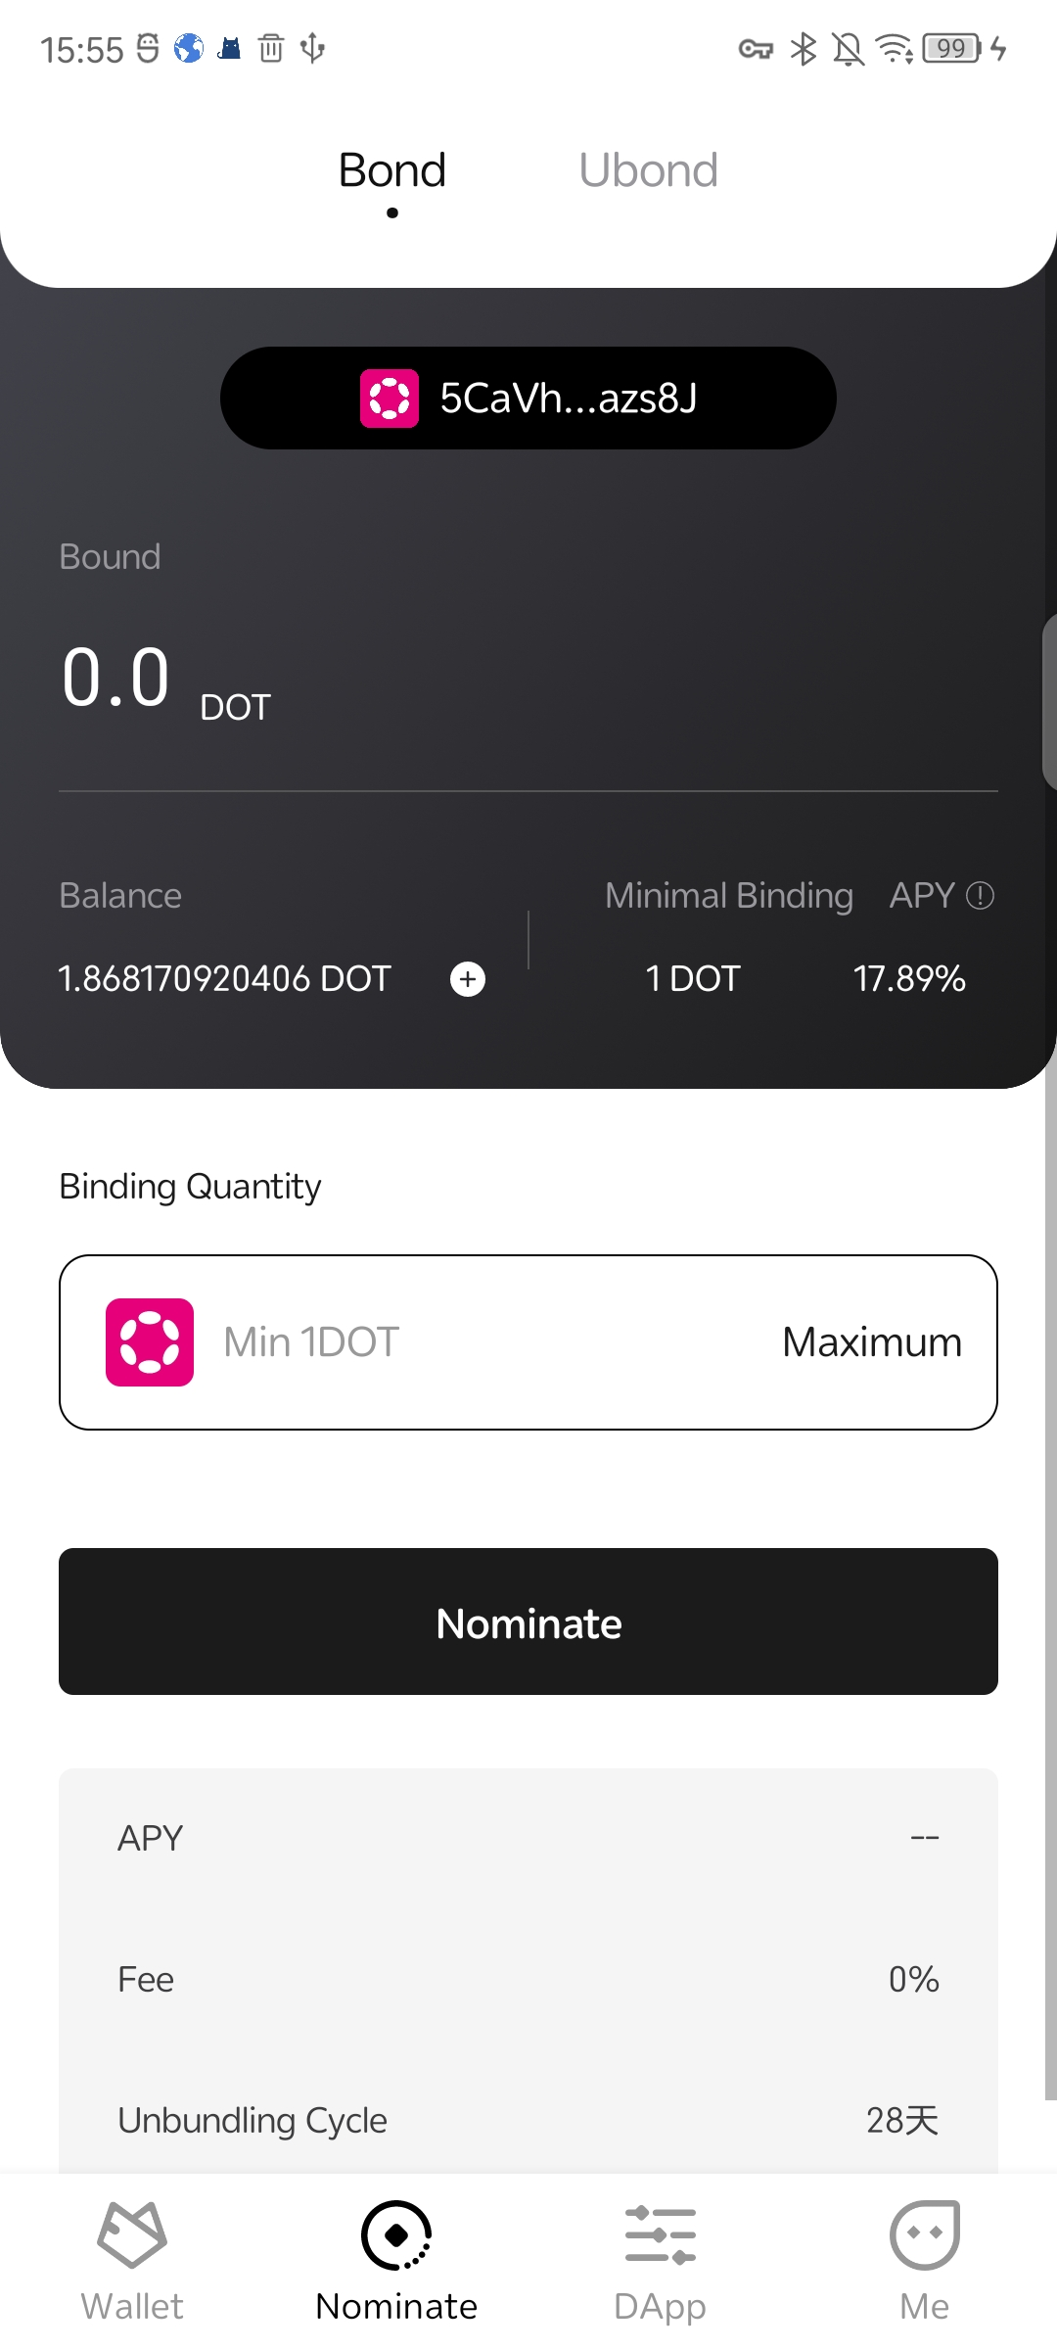
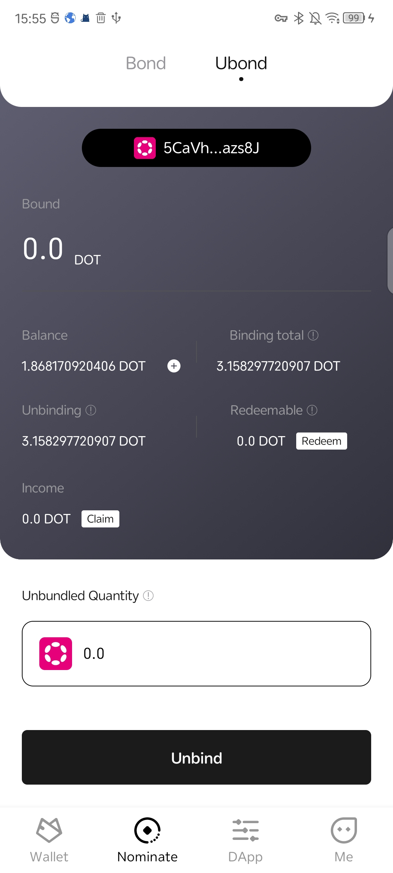
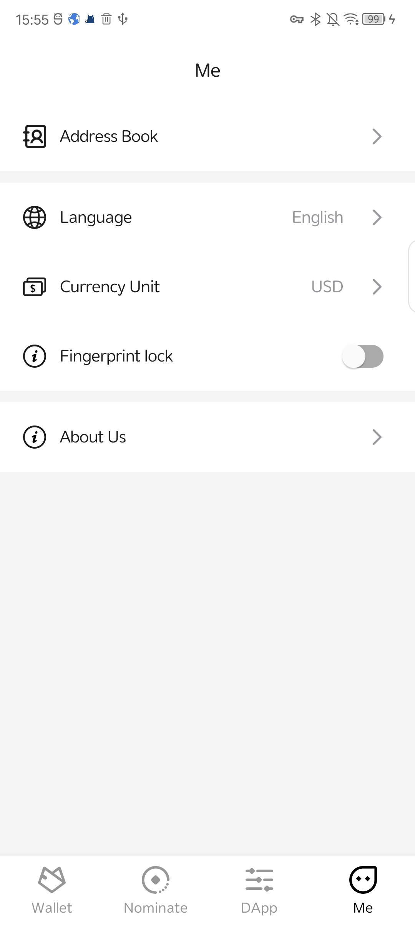
Main Interface
BT
Wallet

Slide 20
Demo and Video
BT
Wallet
1、Demo Address
https://www.pgyer.com/BT_stageEnv_v1
2、Demo Video Address
BT wallet
https://youtu.be/qJgq0pak7ds
BT wallet demo
https://youtu.be/dm98-R1B7m4

Slide 21

BT
Wallet
05
Future Plan

Slide 22
Road Map
BT
Wallet
Nominator 2.0
Valut contract creation
Realize DOT asset cross-chain through XCMP
Control Pool creation
CESS + DAO
Build a decentralized data trading market based on CESS
DAO Organization Creation
2022.Q4
2023.Q1
2023.Q2
2023.Q3
2023.Q4
BT wallet V1
BT wallet V2
BT wallet V3
Team building
Encryption Chip Hardware Design
Nominator development
PLBM Smart Algorithm
Polkadot wallet development
Polkadot Network DApp
PLBM Smart Algorithm 2.0
Support Polkadot Network Vote
Nomination Pool

Slide 23
BT
Wallet
THANK YOU！

